Slide 1
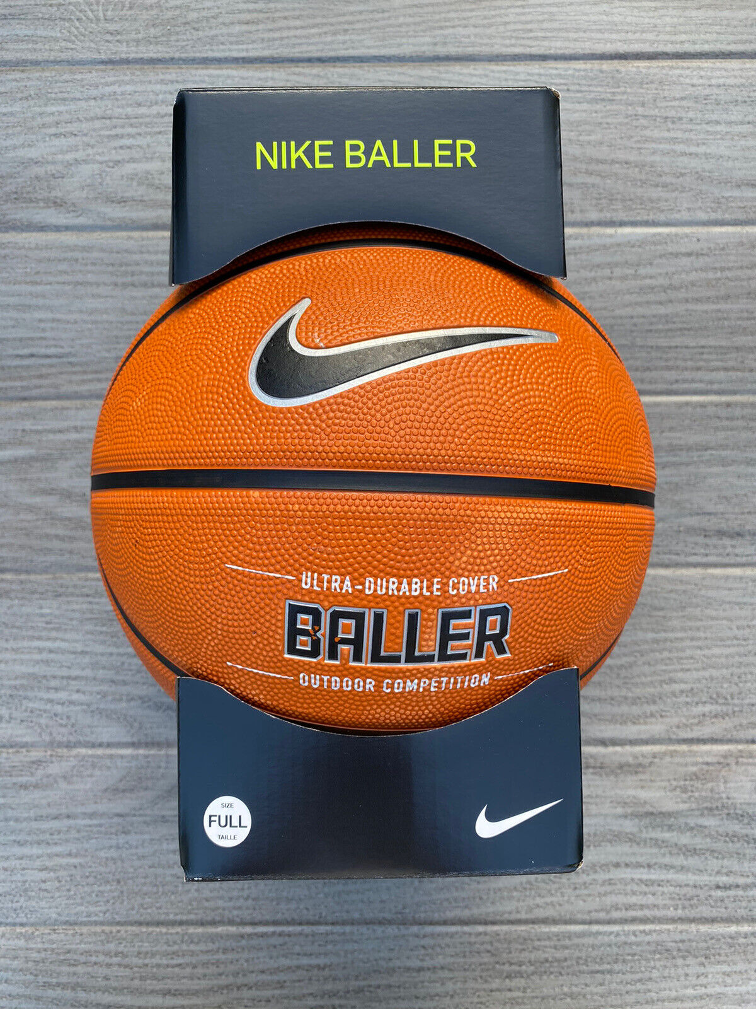
NIKE FACTORY SCENARIO
Justice Inkoom

Slide 2
SCENARIO
A Nike factory in Hanover, MD, makes soccer balls and basketballs. A soccer ball takes 1.5 hours of machine time and 3 hours of a worker's time in its making while a basketball takes 3 hours of machine time and 1 hour of a worker's time. In a day, the factory can produce no more than 42 hours of machine time and 24 hours of worker's time. The profit on a soccer ball is $20 and the profit on a basketball is $10. The manager wants to maximize the daily profit.

Slide 3
LINEAR PROG. MODEL
 | s | b
Variables: | 4 | 12
Where, s is the number of soccer balls made in a day and b is the number of basketballs made in a day.
Together, the s and b are the decision variables in this linear programming problem.
Objective (Max): | s | b | total:
Daily Profit: | $20 | $10 | $200
Constraints: | s | b | LHS | SIGN | RHS
machine time: | 1.5 | 3 | 42 | <= | 42
worker time: | 3 | 1 | 24 | <= | 24

Slide 4
QUESTIONS
What are the decision variables in this scenario?
Answer: Number of soccer balls produced per day and number of basketballs produced per day.
Let s represent the number of soccer balls produced in one day and let b represent the number of basketballs produced in one day. Find the objective function for this scenario.
Answer: 20s + 10b

Slide 5
QUESTIONS CONT’D.
Let s represent the number of soccer balls produced in one day and let b represent the number of basketballs produced in one day. Identify the constraints for this problem.
Answer: 1.5s + 3b ≤ 42 and 3s + b ≤ 24
How can the factory maximize its profit?
Answer: Produce 4 soccer balls and 12 basketballs per day to get a maximum profit of $200.

Slide 6
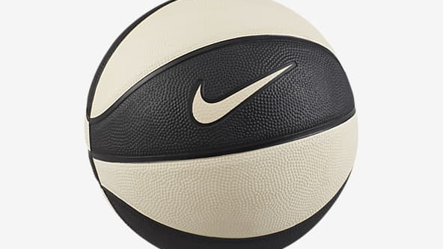
THANK YOU

